Slide 1
Early Readmission Risk in Diabetic Patients
IE 7275 – Data Mining in Engineering

Slide 2
Problem Definition
The primary goal of this project is to predict early patient readmission within 30 days of hospital discharge. The analysis aims to identify key predictors influencing readmission, including patient demographics, length of hospital stay, lab results, medication usage, and discharge details. By uncovering these insights, the project seeks to support improved diabetes management in hospital settings, enhance the allocation of healthcare resources, reduce overall hospital costs, and ultimately improve patient care outcomes.

Slide 3
Project Objective
Develop a predictive classification model to identify diabetic patients at risk of readmission within 30 days of discharge, with a focus on maximizing recall.
Generate actionable insights by identifying the most influential factors contributing to early readmission using model interpretability techniques.
Support hospital decision-making by providing a data-driven approach to improve patient care, optimize resource allocation, and reduce avoidable readmissions.

Slide 4
Key Results
Achieve a recall of at least 60% for predicting readmitted patients (Class 1), ensuring higher sensitivity to detect at-risk individuals.
Minimize false negatives to prioritize early identification of patients likely to be readmitted within 30 days.
Use statistical tests (Chi-Square) and feature importance techniques (Random Forest) to identify influential variables such as age, diagnoses, medical specialty, insulin usage, and number of inpatient visits that contribute to readmission risk.

Slide 5
Key Performance Indicators (KPI)
Model Accuracy (%) – Measures the proportion of correctly predicted readmissions and non- readmissions
Feature Contribution Score – Quantifies the weight of each identified factor in readmission risk prediction.
Recall for Readmitted Patients (%) – Measures how well the model identifies actual readmitted patients.

Slide 6
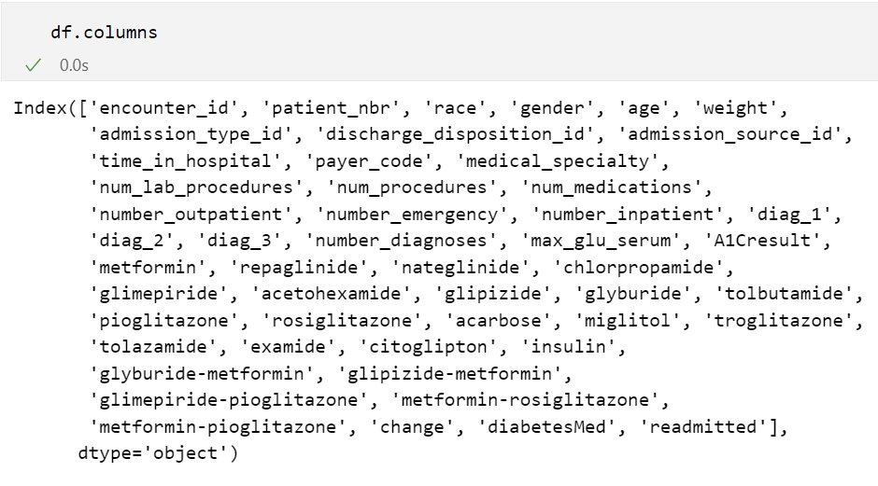
Data Description
The dataset name is Diabetes data of 130-US Hospitals. It is a multivariate data with categorical and integer feature types. The number of features and instances is 50 and 101766 respectively.
Data Source: https://archive.ics.uci.edu/dataset/296/diabetes+130-us+hospitals+for+years+1999-2008

Slide 7
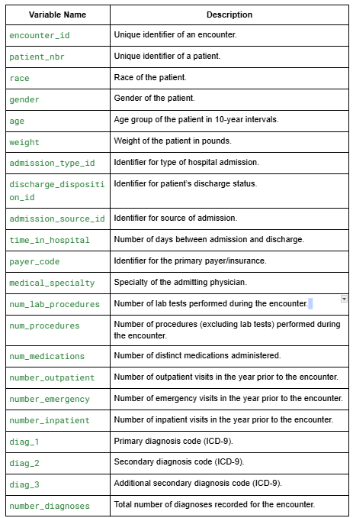
Variable Description

Slide 8
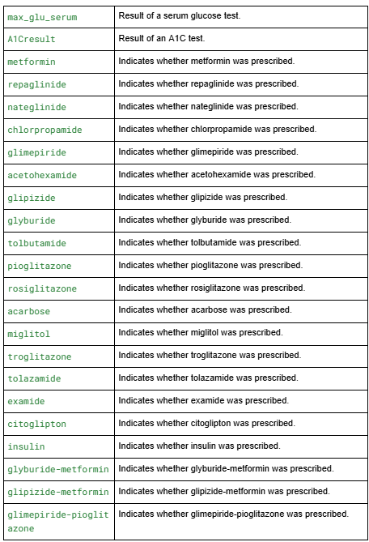
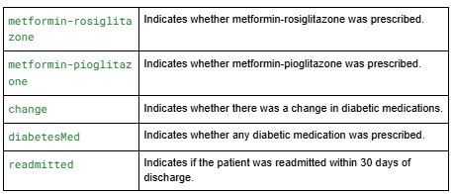
Variable Description

Slide 9
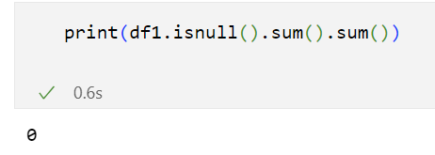
Data Cleaning and pre-processing
To handle missing values in the dataset, we filled them with the label 'missing' instead of using imputation methods, as this is medical data and such replacements could lead to misleading interpretations.

Slide 10
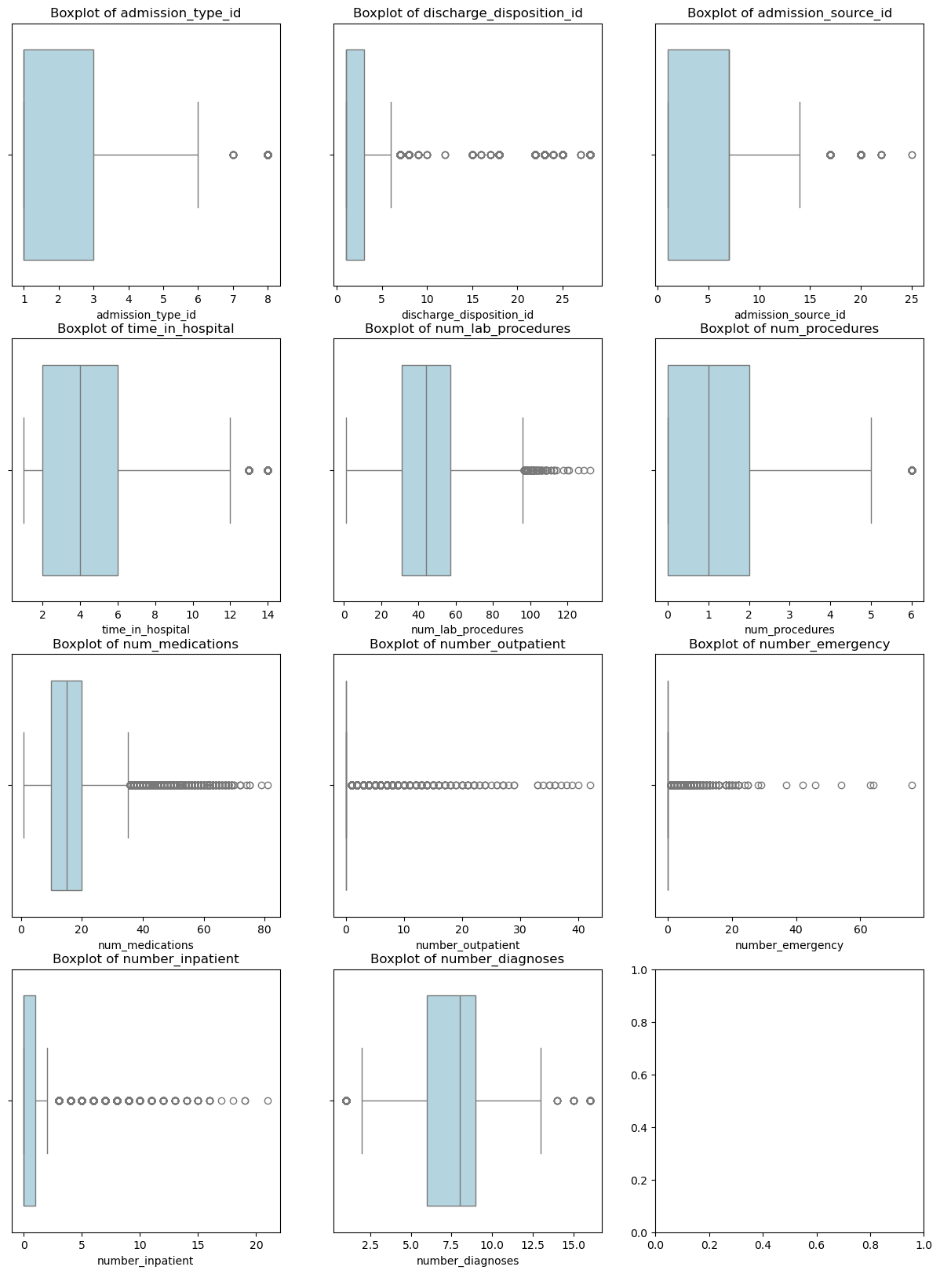
Exploratory Data Analysis
To better understand the data distribution and detect outliers, we used boxplots and histograms. These visualizations helped in gaining insights into the spread, skewness, and potential anomalies in the dataset.

Slide 11
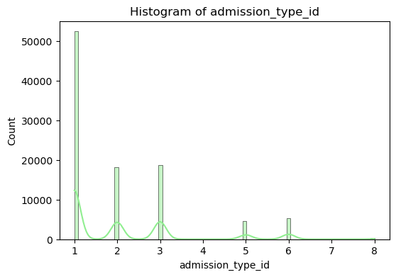
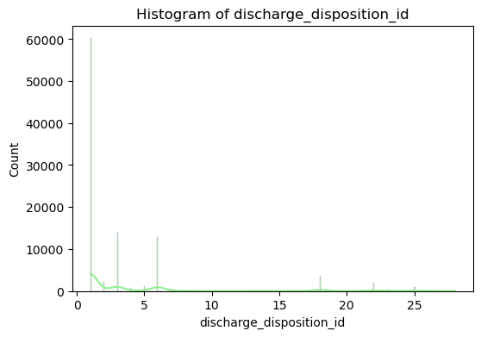
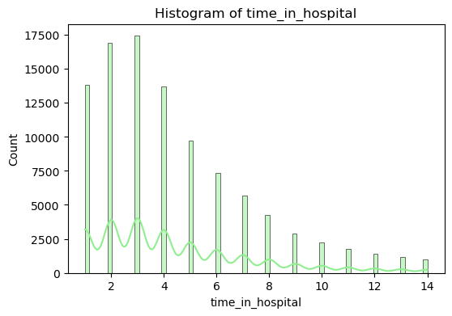
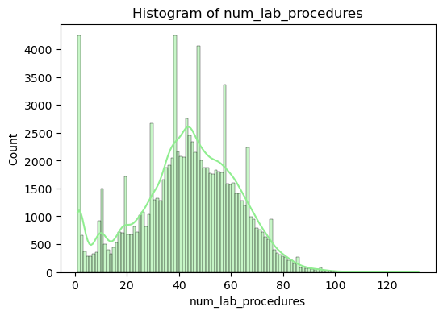
EDA

Slide 12
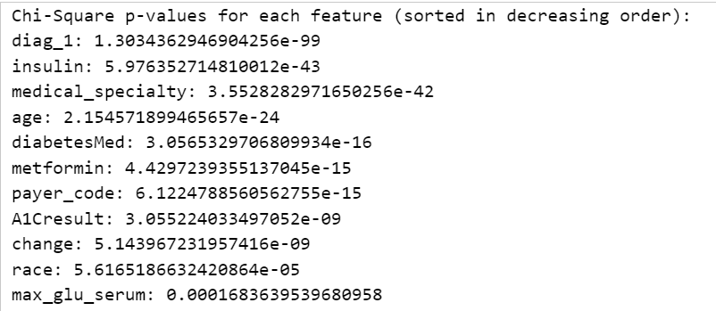
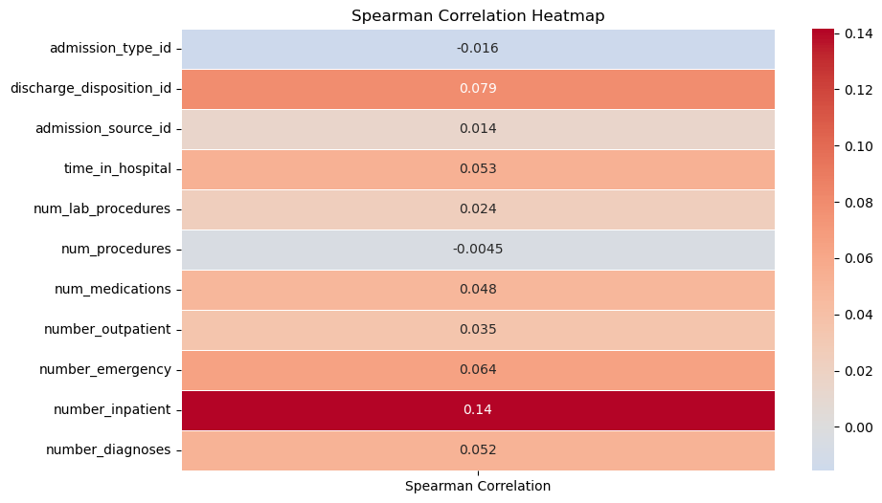
Feature Selection
For feature selection, we used Spearman correlation analysis for numerical variables to identify strong relationships with the target variable. For categorical features, we applied the Chi-square test to determine their statistical significance, helping us select the most relevant features for the model.

Slide 13
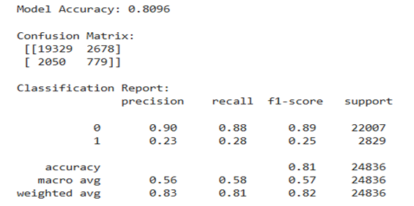
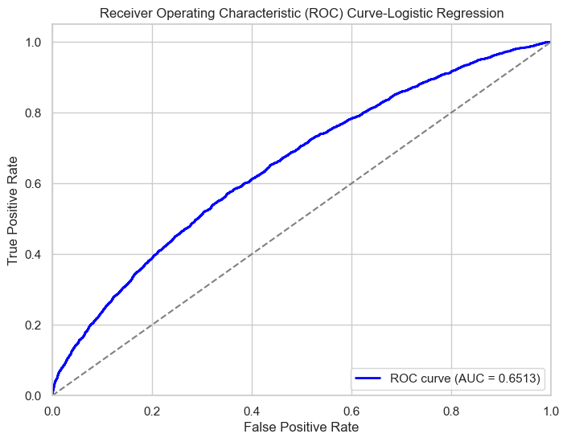
Data Mining Models
Logistic Regression
A logistic regression model was trained using a balanced class weighting strategy to handle class imbalance. The model achieved an accuracy of 81%, demonstrating its ability to classify instances correctly.

Slide 14
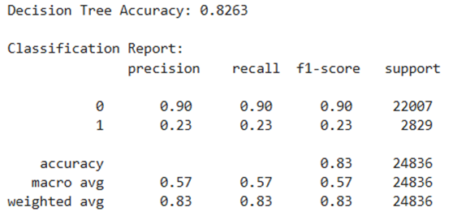
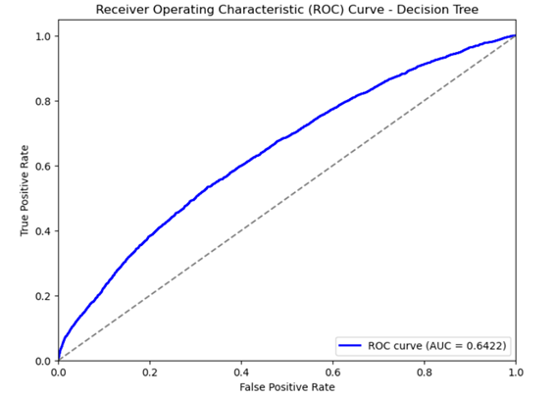
Data Mining Models
Decision Tree Classifier
The decision tree model gave a better overall accuracy of 83%, showing a slight improvement in how well it classifies patients. However, the recall for class 1 (patients who were readmitted) was still low at 23%, meaning the model is not doing a good job at identifying most of the patients who actually get readmitted.

Slide 15
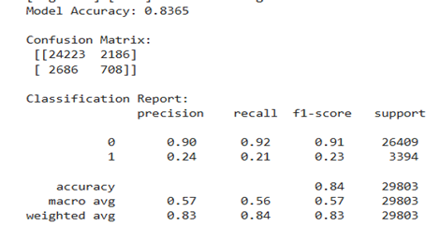
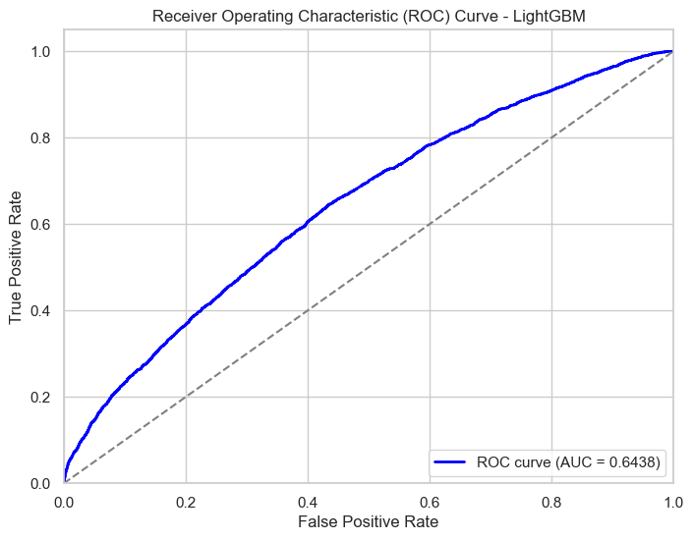
Data Mining Models
LightGBM
The LightGBM model had the best accuracy at 84%, doing better than both logistic regression and the decision tree. But its recall for class 1 (readmitted patients) was only 21%, which is a bit lower than logistic regression. This means it missed more actual readmissions. However, it had a high specificity of 92% for class 0, meaning it was very good at correctly identifying patients who were not readmitted.

Slide 16
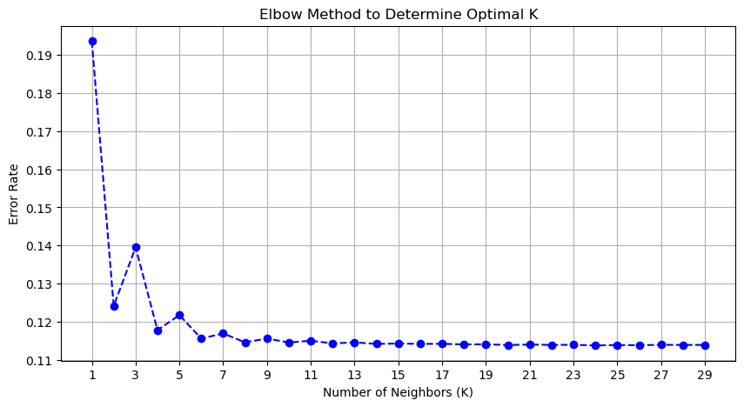
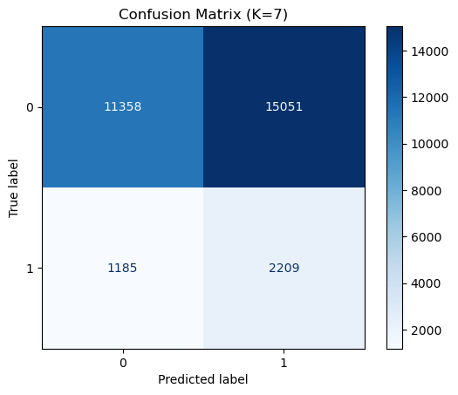
Data Mining Models
KNN
For the KNN model, the Elbow Method suggested 7 as the optimal number of clusters. Using K=7, the KNN model achieved 45.52% accuracy. It had a high recall of 65.09% for class 1, meaning it detected many positive cases, but precision was low at 12.80%, indicating many false positives.

Slide 17
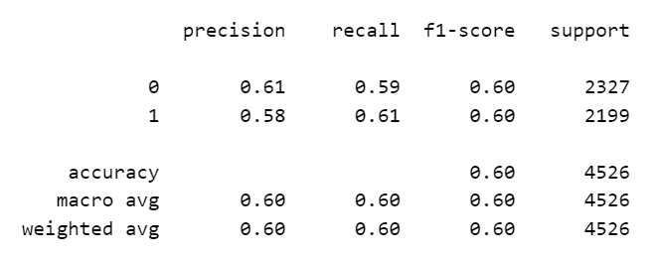
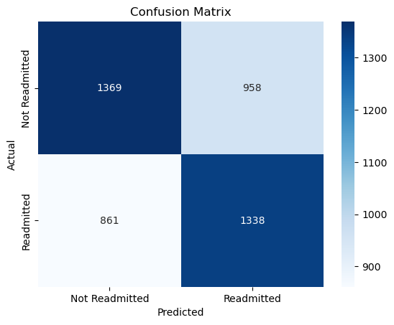
Data Mining Models
LSTM
The LSTM model achieved 60% accuracy, with balanced precision (58%) and recall (61%) for class 1. Its F1-score of 60% shows a good balance between detecting positive cases and avoiding false positives, making it more reliable than the KNN model for this task.

Slide 18
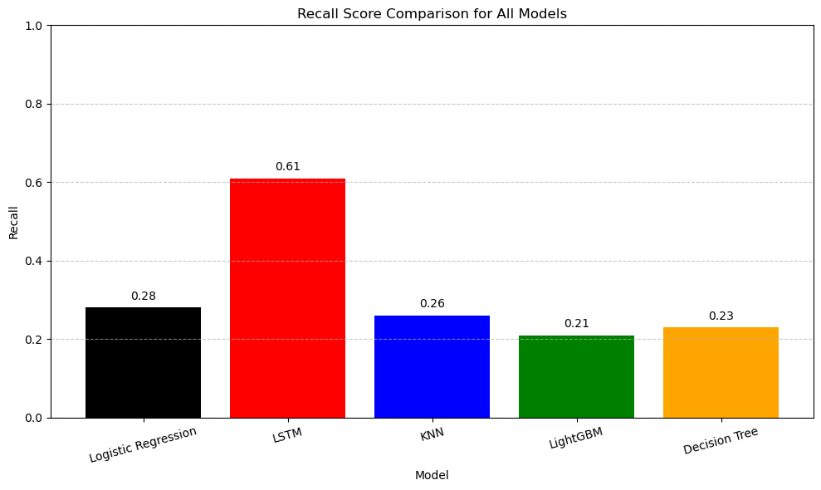
Performance Evaluation and Model Selection
LSTM model is best suited for the project, as it offers a strong balance between recall (61%) and precision (58%).

Slide 19
Challenges faced during the project
One of the main challenges faced during the project was the high class imbalance in the dataset, with significantly fewer patients readmitted within 30 days (Class 1) compared to those who were not (Class 0). This imbalance led to biased model predictions favoring the majority class. We applied balancing techniques such as oversampling, undersampling, and SMOTE to improve minority class detection. Additionally, we performed hyperparameter tuning to enhance model performance, but the results still fell short of the desired recall. This highlights the difficulty of accurately predicting rare events in healthcare data.

Slide 20
Thank you

